Slide 1
Green Havens: A Study of Environmental Conditions in Public Parks

Slide 2
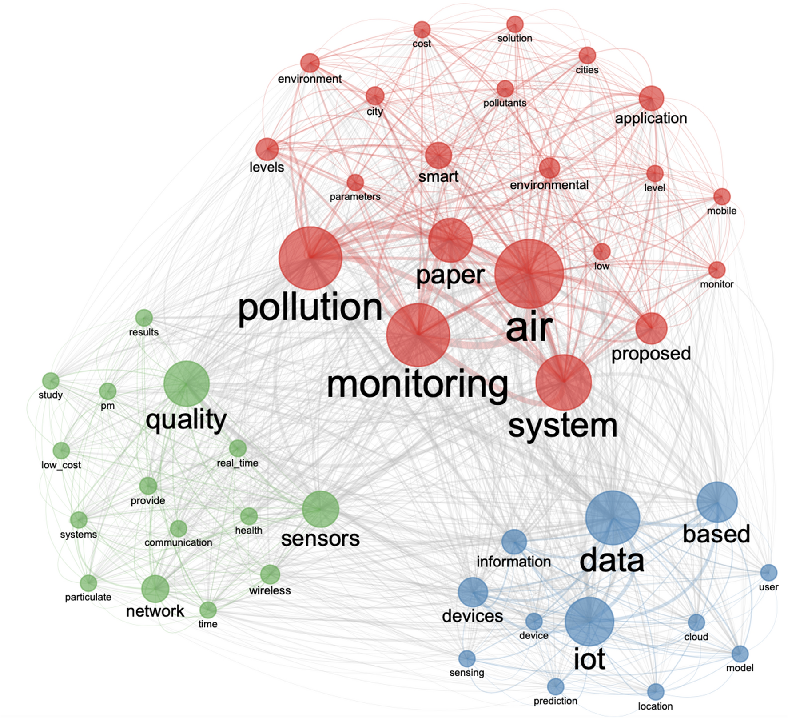
problem definition :
IoT stands for Internet of Things. It refers to the interconnectedness of physical devices, such as appliances and vehicles, that are embedded with software, sensors, and connectivity which enables these objects to connect and exchange data. This technology allows for the collection and sharing of data from a vast network of devices, creating opportunities for more efficient and automated systems.
Internet of Things (IoT) is the networking of physical objects that contain electronics embedded within their architecture in order to communicate and sense interactions amongst each other or with respect to the external environment. In the upcoming years, IoT-based technology will offer advanced levels of services and practically change the way people lead their daily lives. Advancements in medicine, power, gene therapies, agriculture, smart cities, and smart homes are just a very few of the categorical examples where IoT is strongly established.
﻿
IoT is network of interconnected computing devices which are embedded in everyday objects, enabling them to send and receive data.
Over 9 billion ‘Things’ (physical objects) are currently connected to the Internet, as of now. In the near future, this number is expected to rise to a whopping 20 billion.

Slide 3
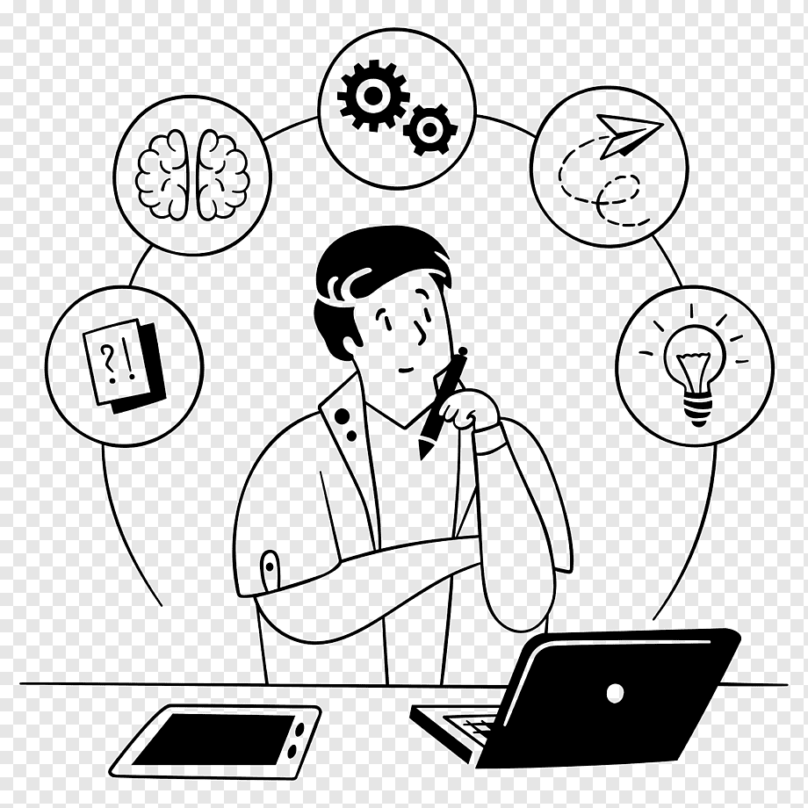
Design thinking Design thinking is a problem-solving approach that focuses on understanding the user's needs and experiences. It involves empathy, creativity, and experimentation to develop innovative solutions. The process includes five stages: empathize, define, ideate, prototype, and test. During the empathize stage, designers observe and engage with users to understand their perspectives and needs. In the define stage, they synthesize their findings and identify the core problem. In the ideate stage, designers generate a wide range of ideas and select the most promising ones. In the prototype stage, they create low-fidelity models to test their ideas. Finally, in the test stage, designers gather feedback from users and refine their solutions.

Slide 4
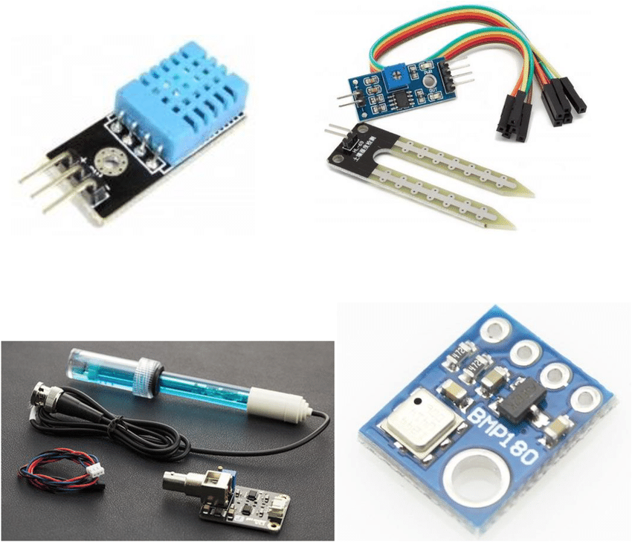
IOT Devices Designs :
Our team has developed a range of IoT devices that are designed to monitor environmental conditions and provide real-time data to help people make informed decisions about their surroundings.
Each device is equipped with a range of sensors that can detect everything from temperature and humidity to air quality and noise levels. The data is then transmitted wirelessly to a central hub, where it can be analyzed and used to generate insights and recommendations for action.

Slide 5
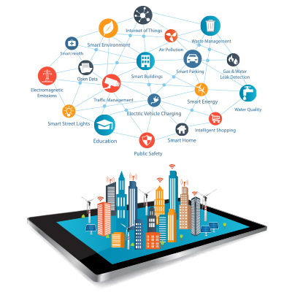
Environmental Monitoring Platform :
Our environmental monitoring platform is designed to help individuals and organizations monitor and track the quality of air, water, and soil in their local communities. By providing real-time data on pollution levels, this platform empowers users to make informed decisions about their health and the health of their environment.
Using a combination of IoT devices and advanced analytics, our platform collects and analyzes data from sensors placed throughout a community. This data is then visualized on a user-friendly dashboard, allowing users to easily understand the current state of their environment and identify areas for improvement.

Slide 6
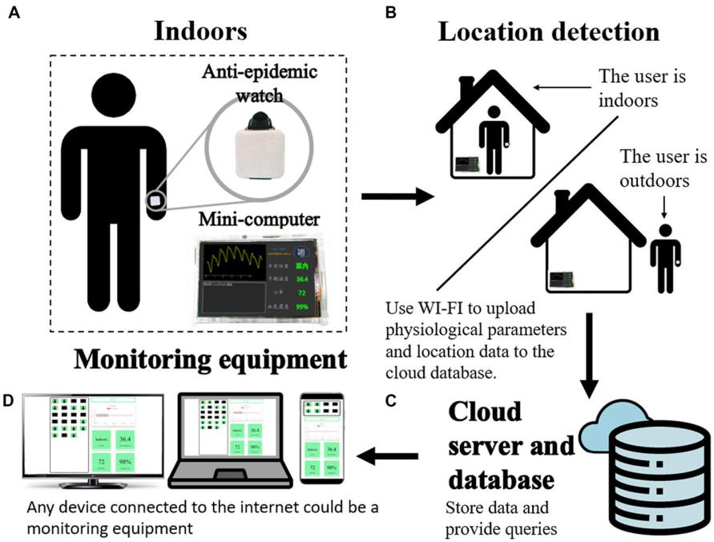
Integration Approach:
vTo ensure seamless integration of our IoT devices with the Environmental Monitoring Platform, we have adopted a modular approach. This involves breaking down the system into separate components that can be developed and tested independently.
Each component is designed to communicate through well-defined APIs, allowing for flexibility in choosing the best technology for each specific task. This also enables us to easily swap out or upgrade individual components without disrupting the entire system.

Slide 7
conclusion
in conclusion, we have explored the problem of environmental monitoring and how IoT devices can help address this issue.
We have also discussed the design thinking process that led to the creation of our Environmental Monitoring Platform, which offers a comprehensive solution for monitoring air and water quality.
By taking responsibility for the environment and using innovative technologies like IoT devices, we can all make a difference in our local communities. Let's work together to create a cleaner, healthier planet for future generations.

